Slide 1
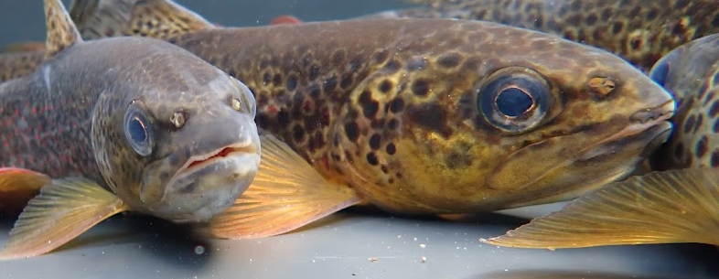
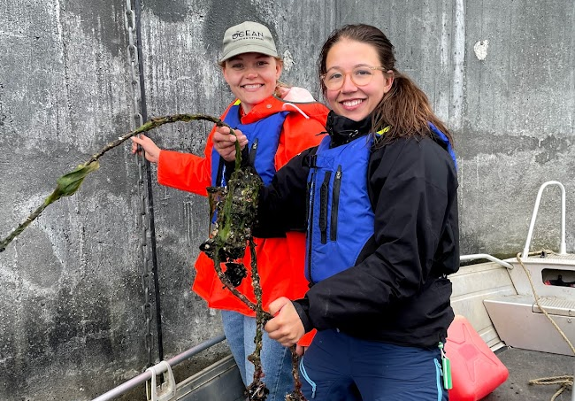
Positioning aquatic animals with telemetry
Robert J. Lennox @fisheriesRobert
Ocean Tracking Network

Slide 2
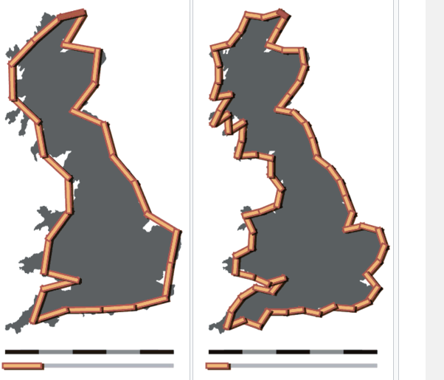
The coastline paradox

Slide 3
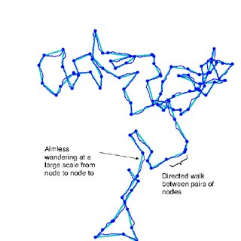

Fractals
A curve whose length depends on the resolution of measurement
A coastline does not have a defined length
Length depends on the resolution at which we measure
Animal movement follows a fractal pattern
Key to understand when considering positioning

Slide 4
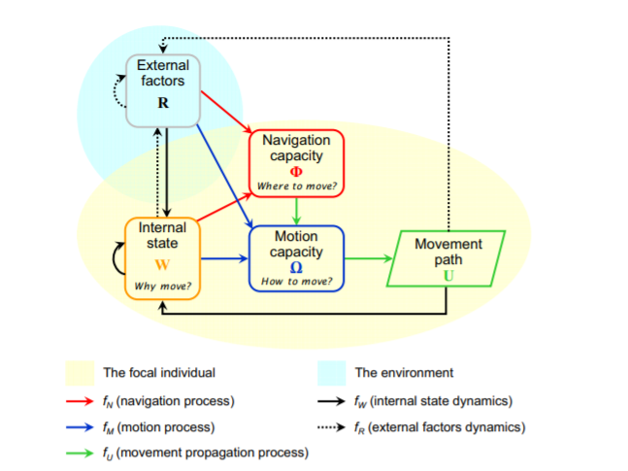
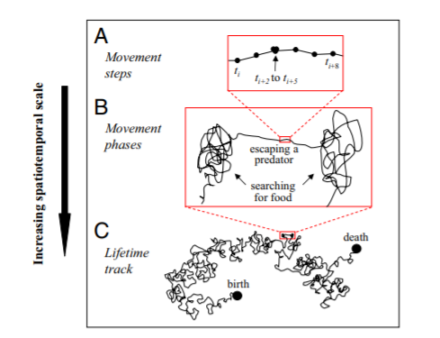
Animal movement
Nathan et al. 2008 PNAS

Slide 5
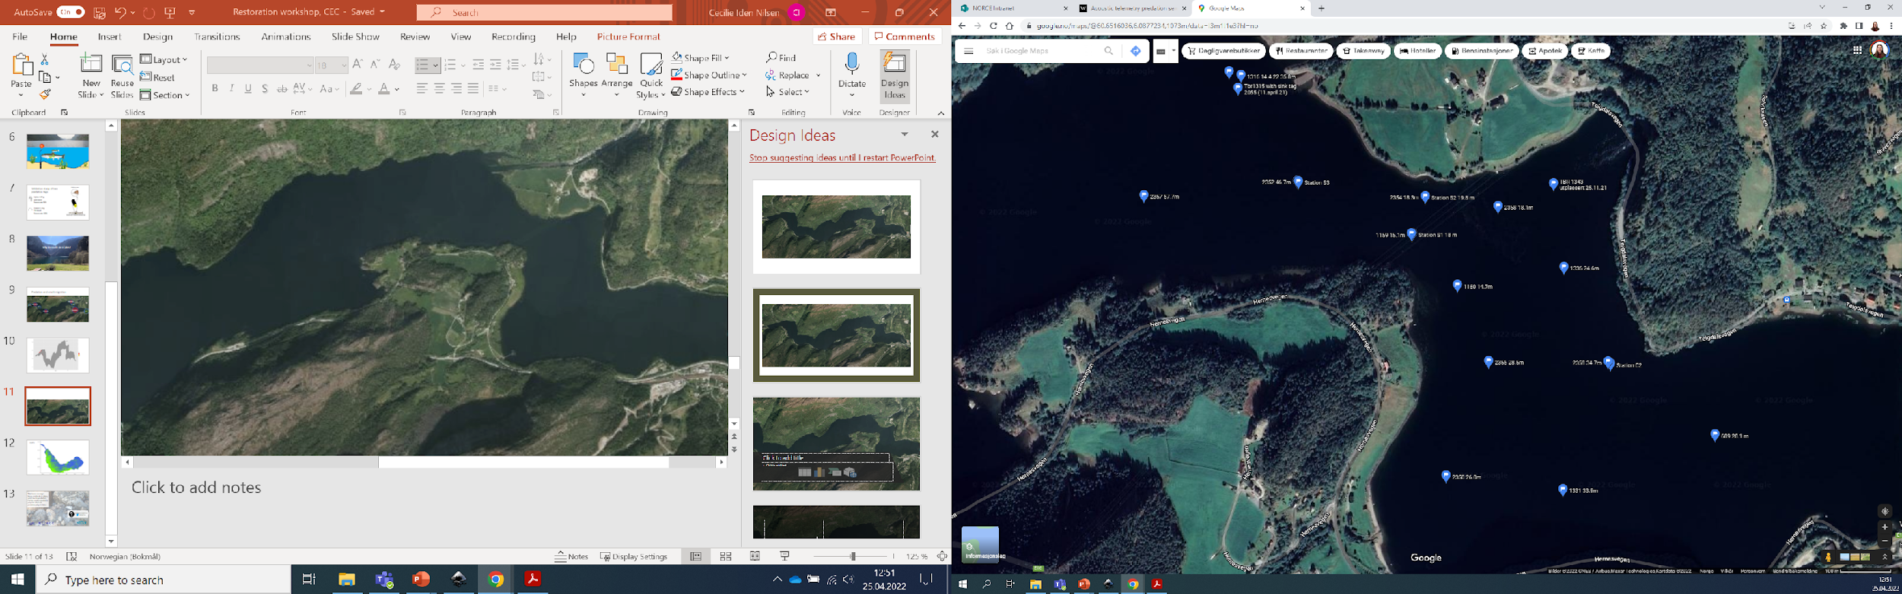
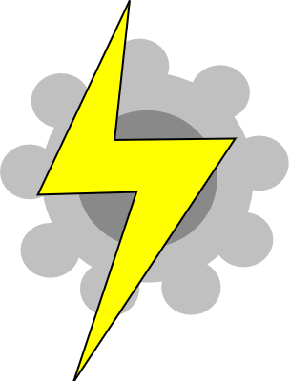

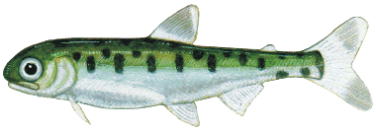
Paths from precise positioning
Path: a high-dimensional fractal connecting a series of positions

Slide 6
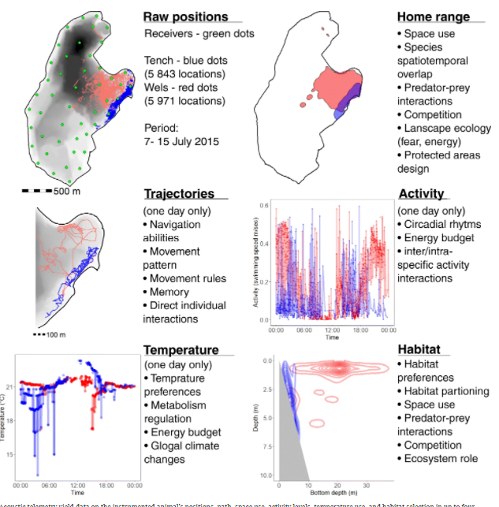
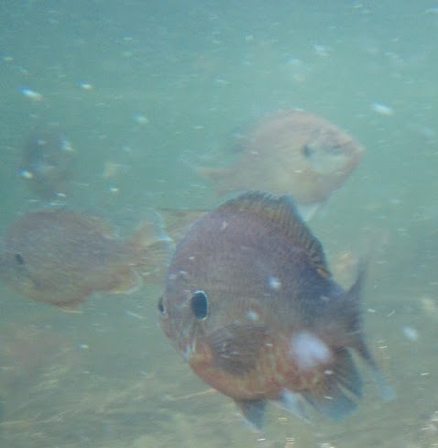
The Path

Slide 7
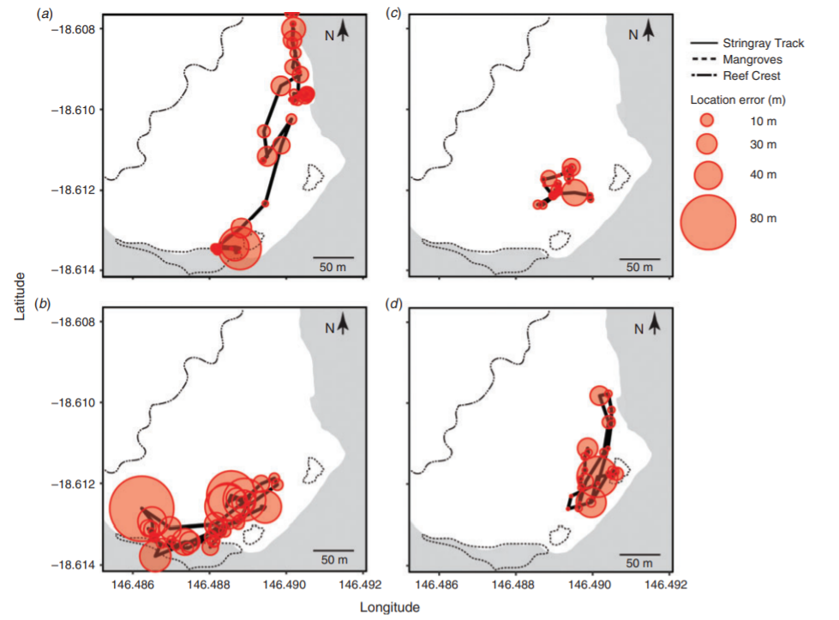
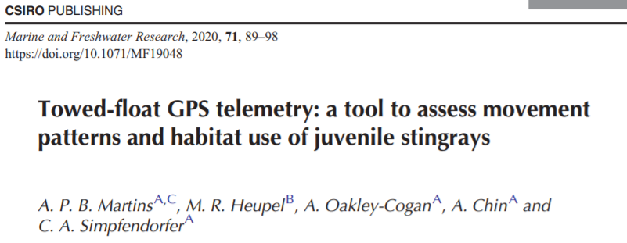
Getting a path is not easy in water
We can get paths from GPS
Impractical in water
But possible for slow-moving, shallow species
E.g. towed-float GPS

Slide 8

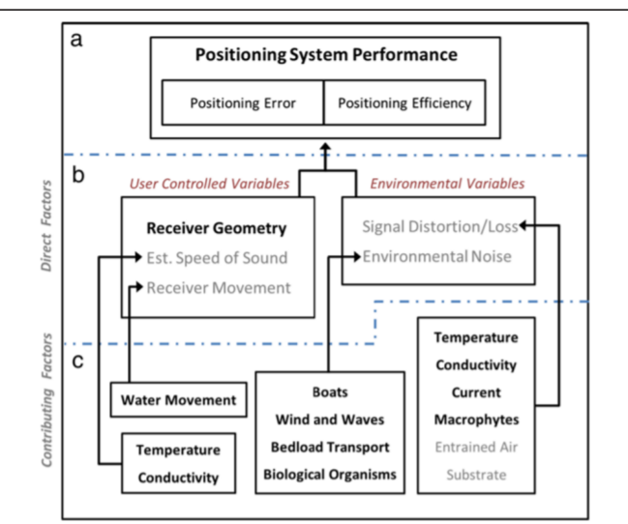
Trilateralization to estimate paths
Many things affect triangulation success
Careful design
Sometimes just too much error

Slide 9
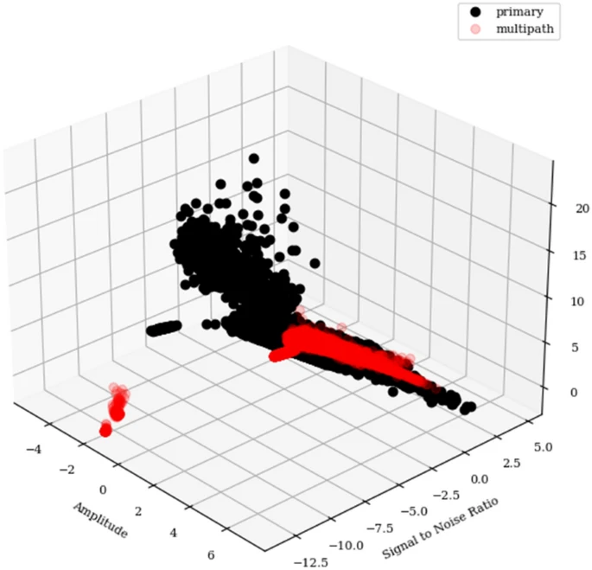

Multipath problem
Surfaces reflect sound
Multiple detections of each tag sequence
Creates multiple paths for a tag
YAPS solutions help
Machine learning solutions?

Slide 10
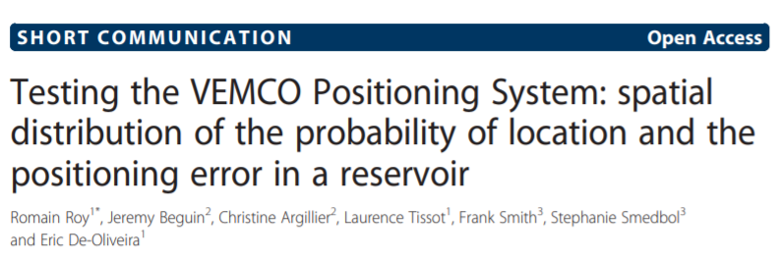
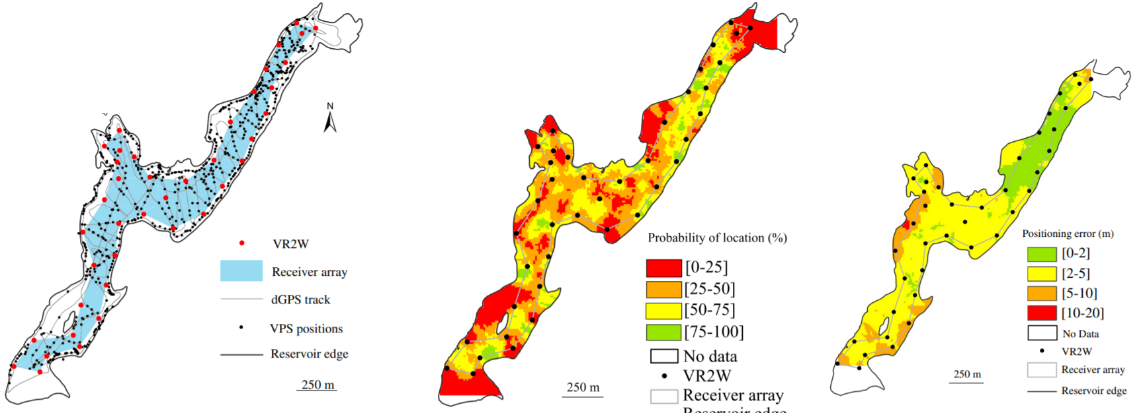
Error and filtering

Slide 11
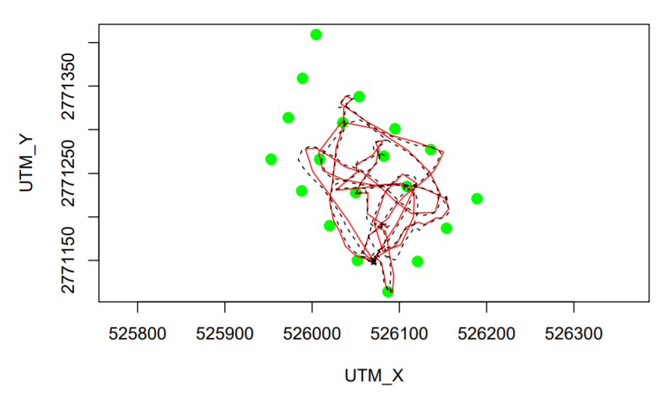
Trilateralization to estimate paths
Time difference of arrival at known locations
Speed of sound
Synchronized clocks
Complicated maths
Amazing when it works
Baktoft et al. 2019 BioRXiv

Slide 12
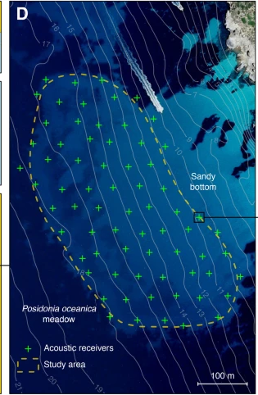
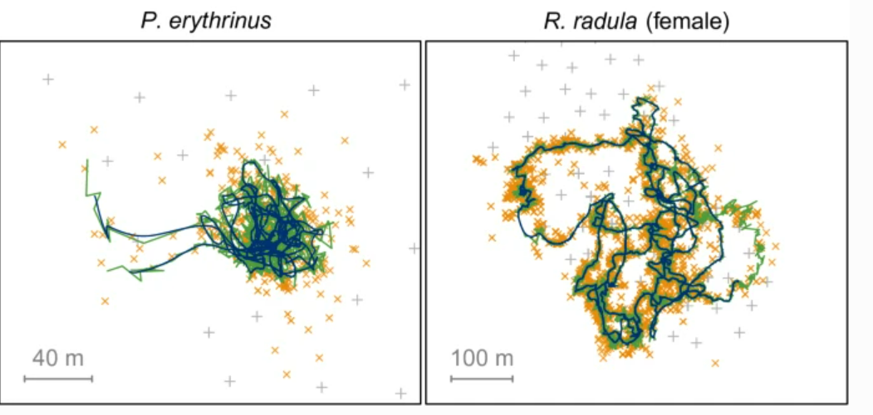
Triangulation - Receiver array
Receivers arranged in a grid
Ideally equilateral triangles
Here 50 m distances
Fixed location measured accurately
Aspillaga et al. 2021 (Anim Biotelem)

Slide 13
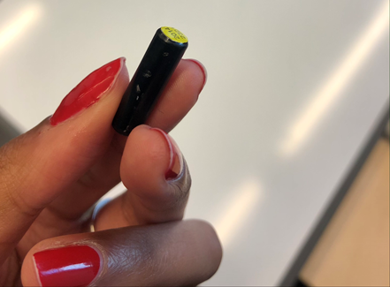
Trilateralization - Transmitters
Power output determines transmission distance
Pulse rate may cause collisions
Sequence of tag pings important (Baktoft et al. 2019 bioRXiv)
Tag | Size | Power output
Lotek (JSAT) | 0.32-3.5 g | 158 dB
Vemco V5-180 kHz | 0.65 g | 143 dB
Thelma 6 mm | 1.2 g | 137 dB
Thelma 9 mm | 4 g | 142 dB
Vemco V9-180 kHz | 3.7 g | 143 dB
Thelma 13 mm MP | 11.5 g | 153 dB
Vemco V13-H | 11 g | 152 dB

Slide 14
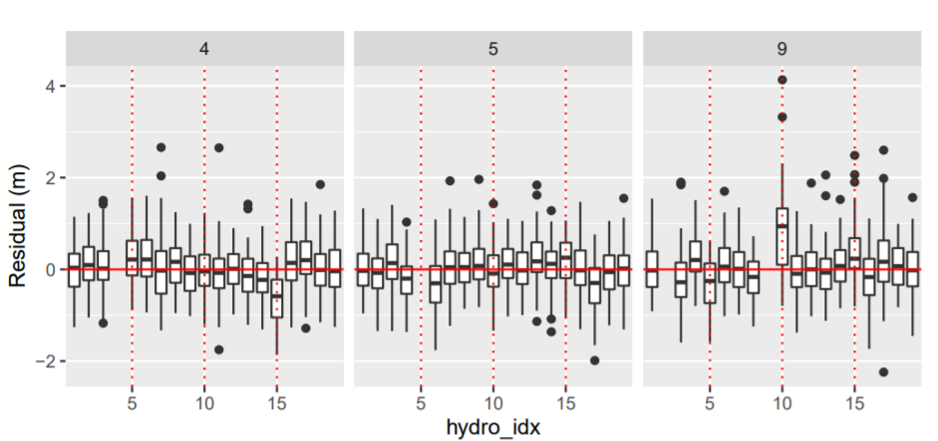
Trilateralization - Synchronization
All clocks drift
Sound travels fast (1.5 km per sec in water or something)
Tiny differences among receivers throws off calculations
Link all receivers by cables, common time keeping device
Synchronization tags pinging to resynchronize clocks
Integrated model in YAPS

Slide 15
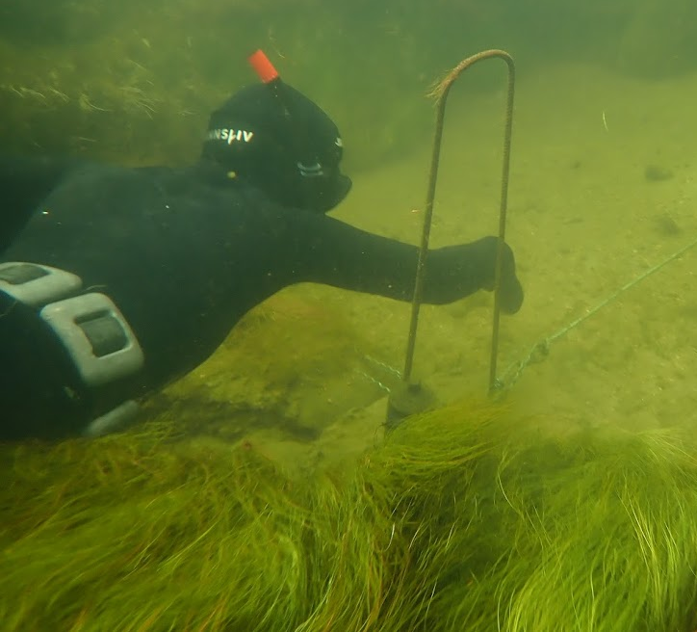
Trilateralization - Tools
Vemco VPS is most familiar
Expensive
Black box
Correlated random walks with crawl
YAPS is amazing
Open source
Flexible
No free lunch :(
Make sure receivers well placed
Make sure clocks can be synced
Make sure tags move through array

Slide 16
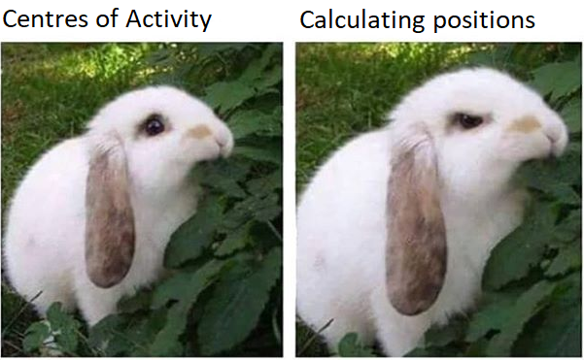
Why do we need positions anyways

Slide 17
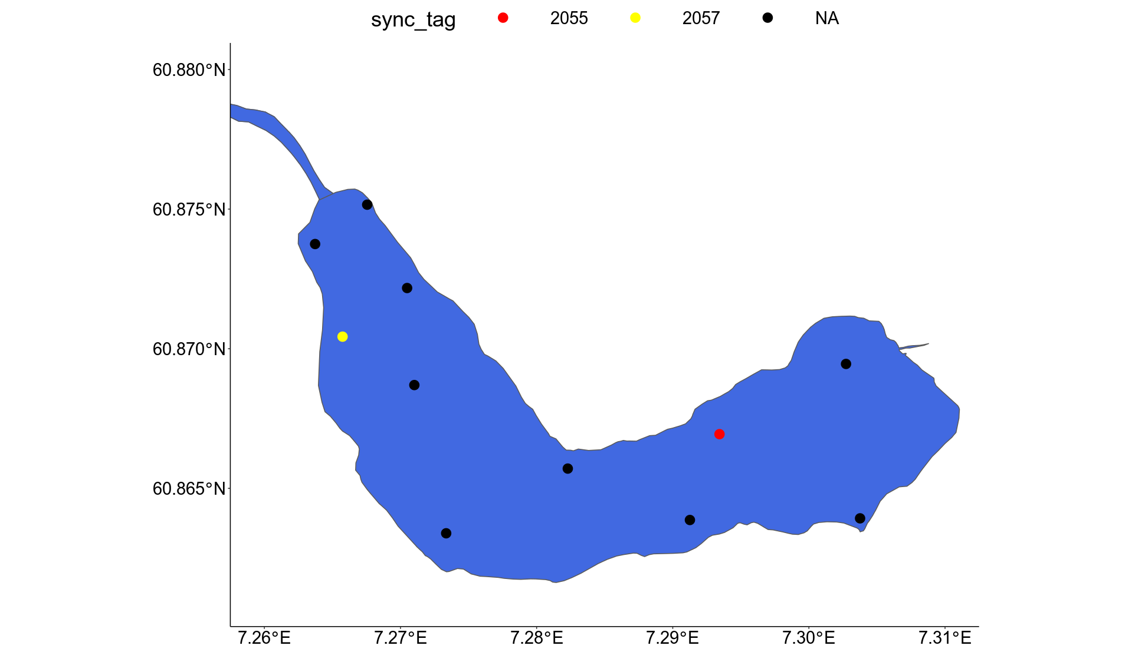
Lake Vassbydgevannet

Slide 18
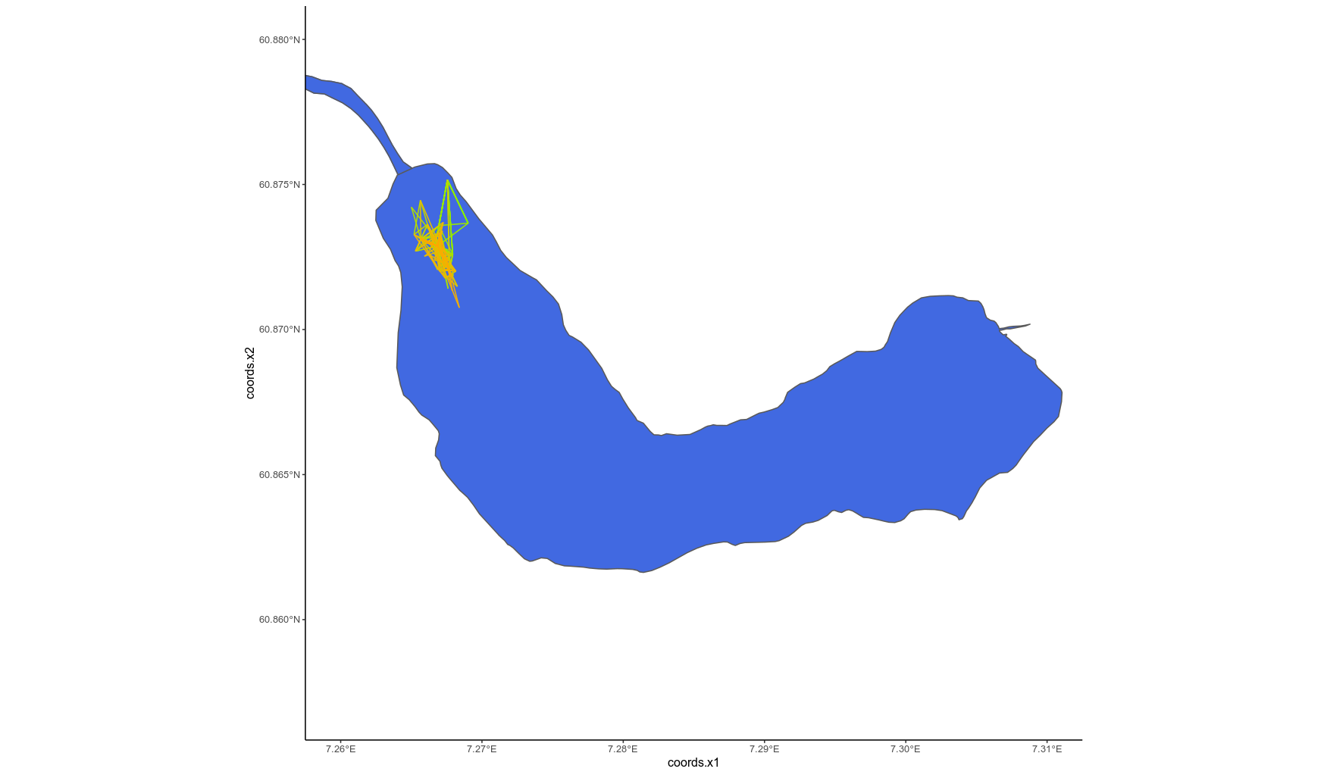
One tag day centre of activity (2 min)

Slide 19
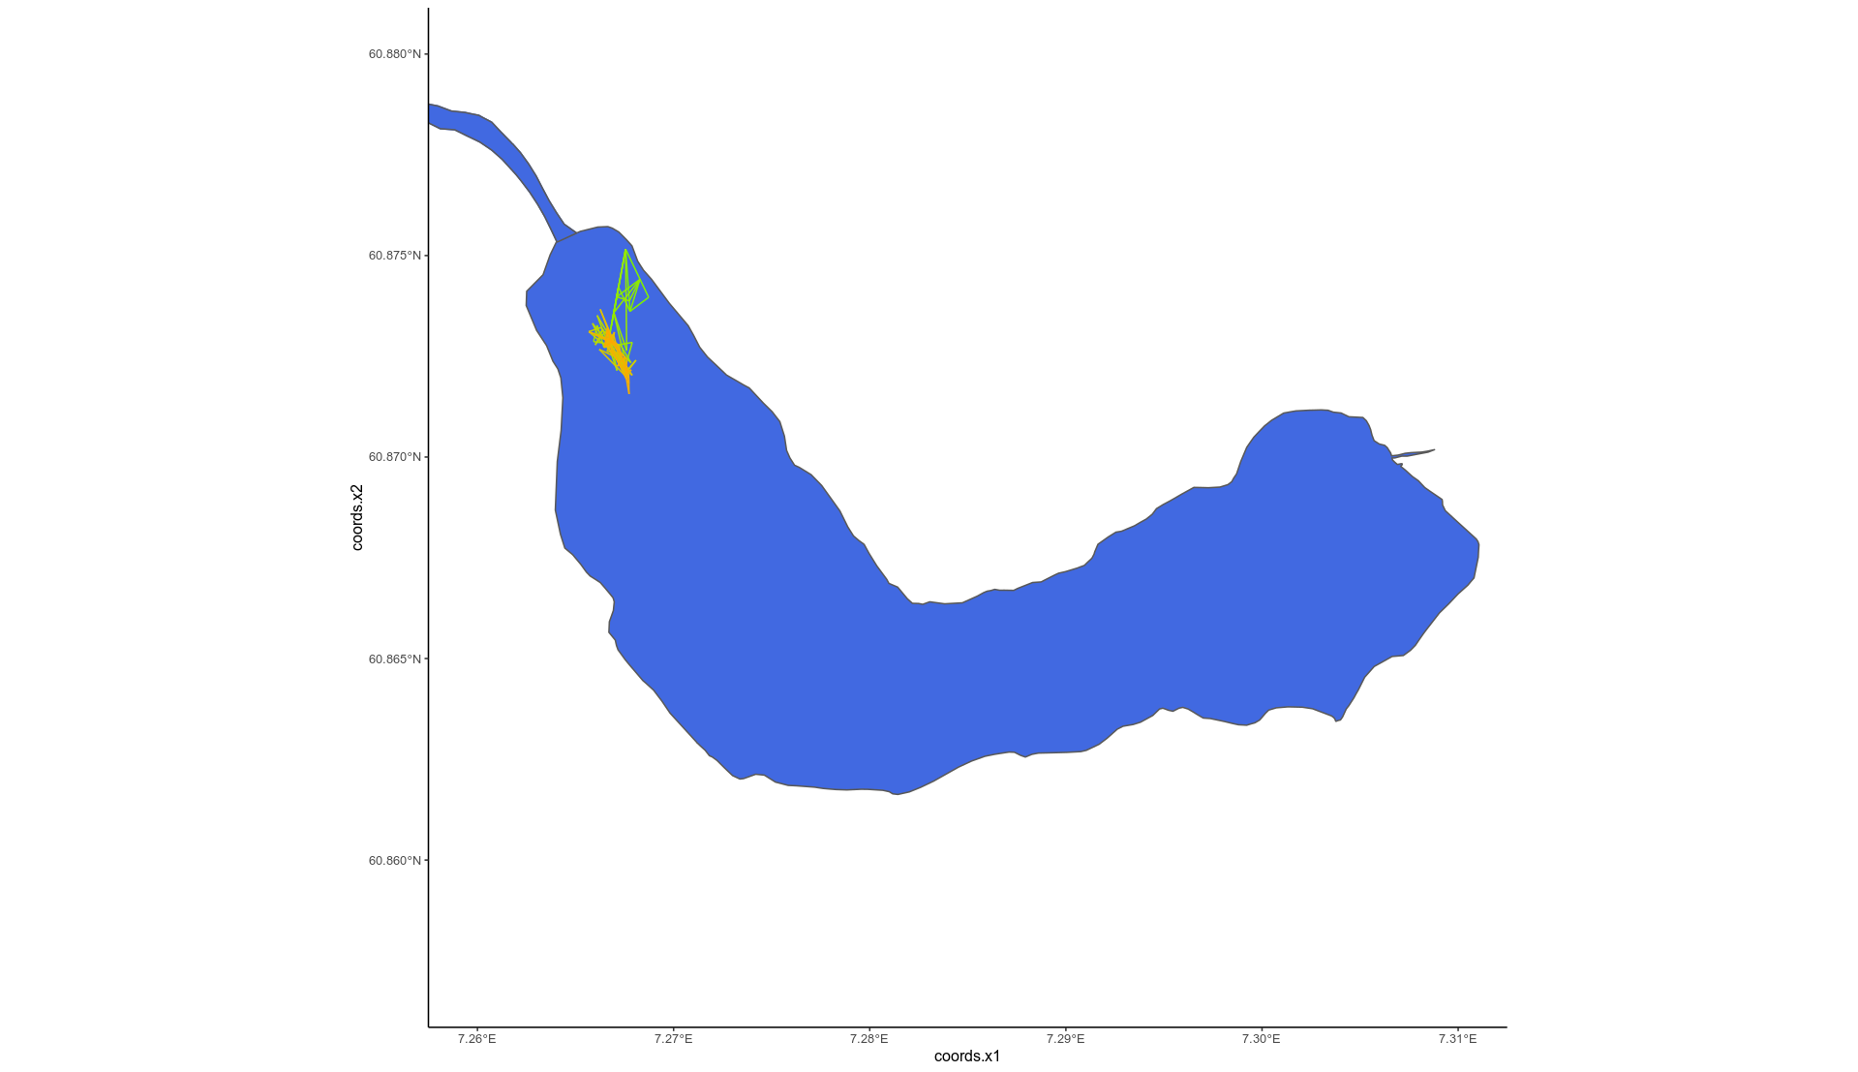
One tag day centre of activity (5 min)

Slide 20

One tag day centre of activity (10 min)

Slide 21

Three data frames
Hydros
Receiver locations
Depths
Sync tags
Tag detections
Sync tags
Also fish
Unsynchronized
Temperature
For speed of sound
Ideally from hydro

Slide 22
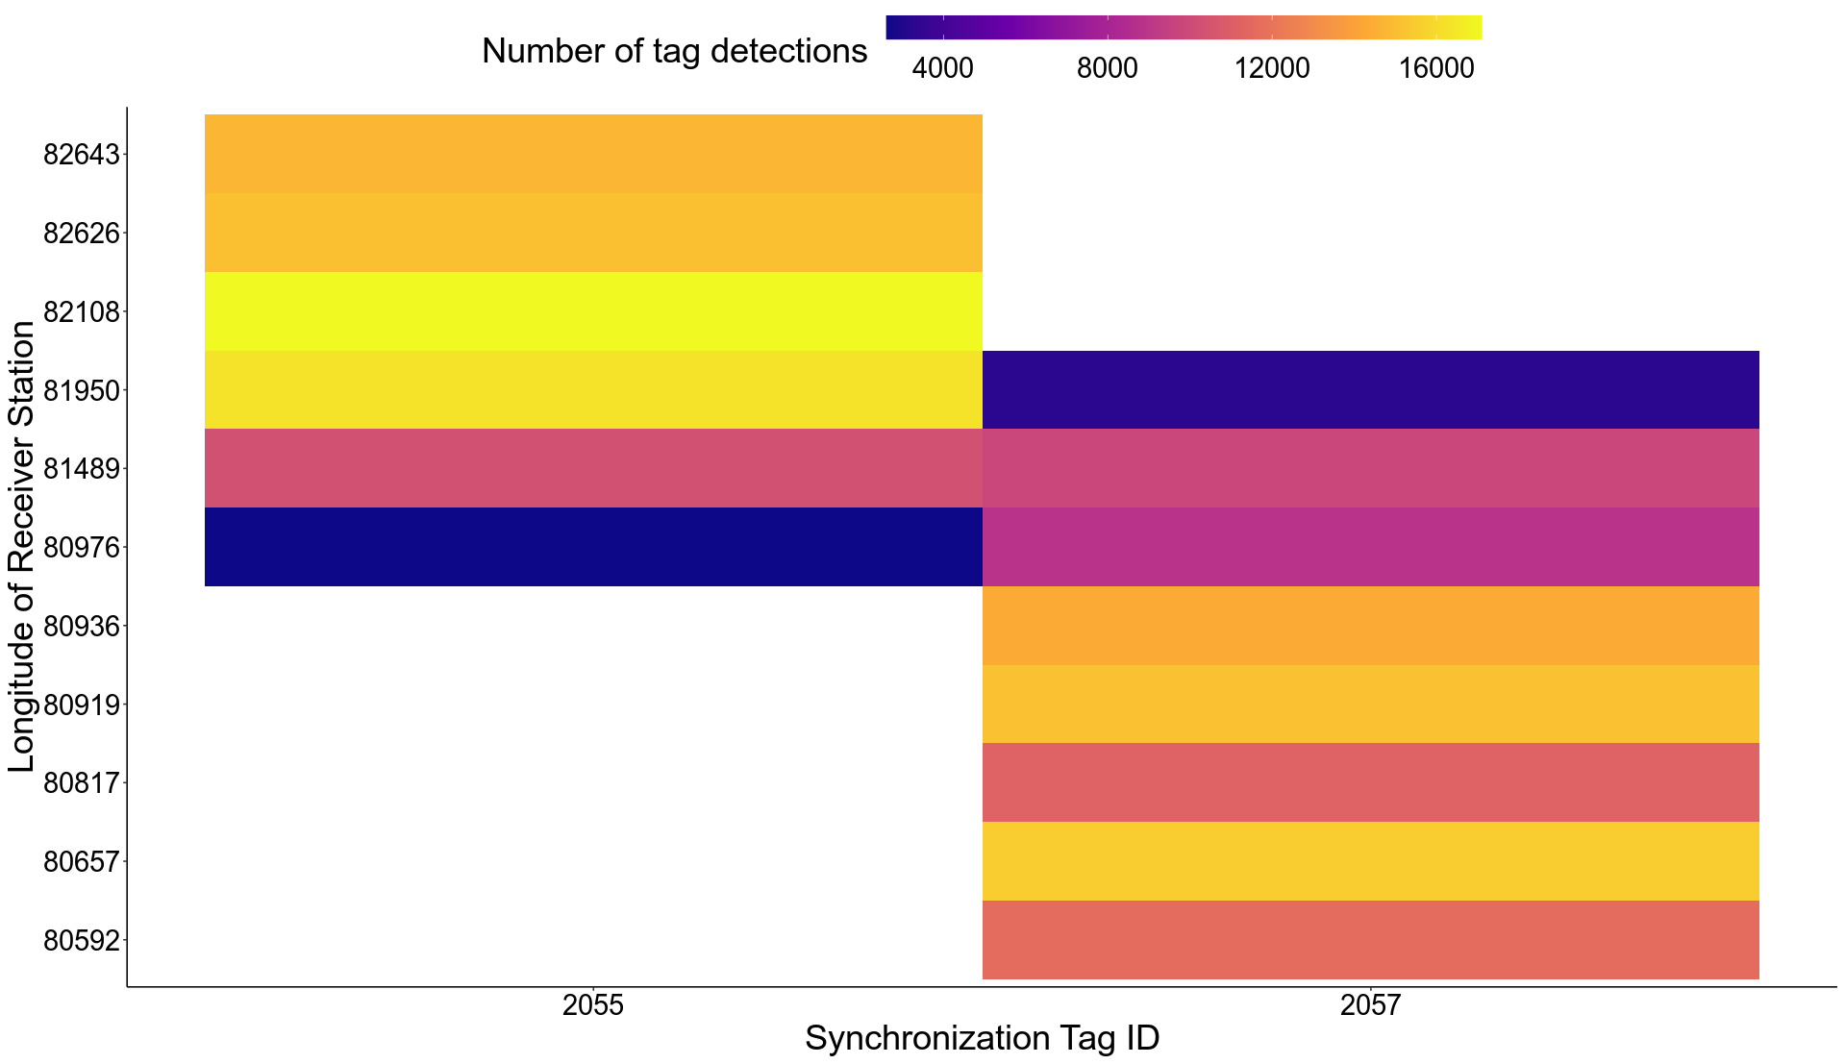
A short dive into positioning

Slide 23
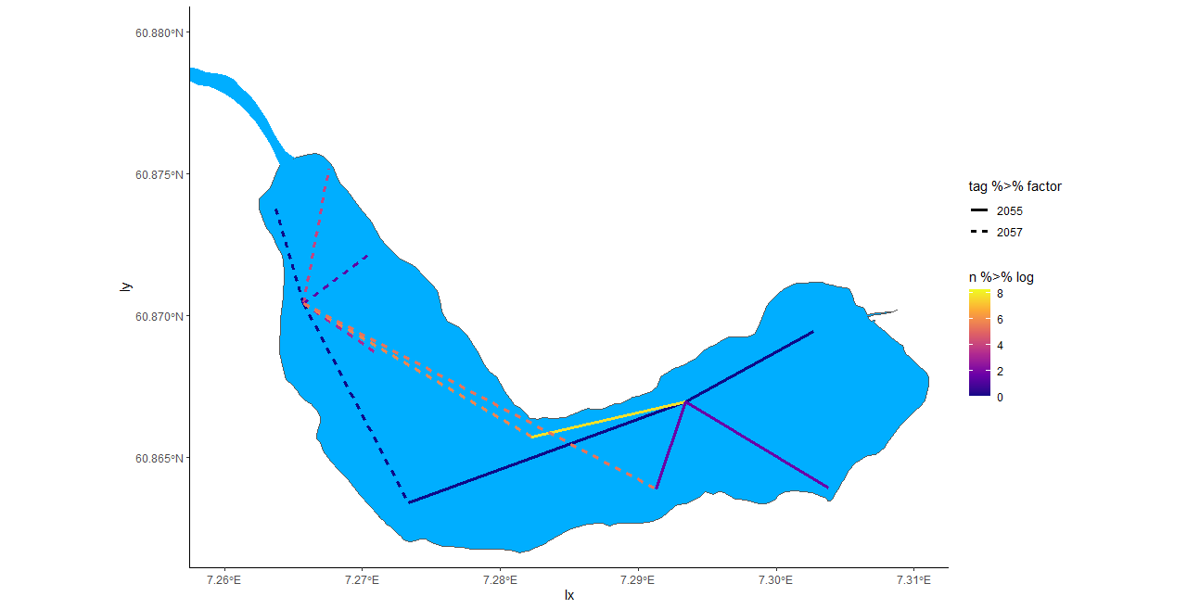
A short dive into positioning

Slide 24
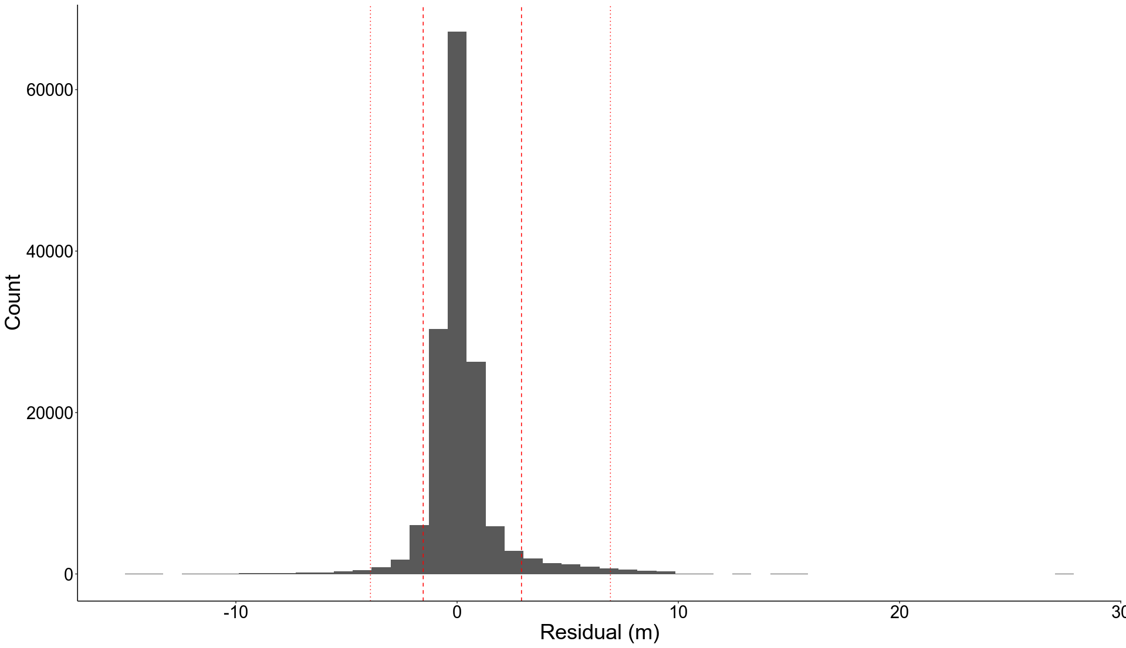
A pretty good synchronization model

Slide 25
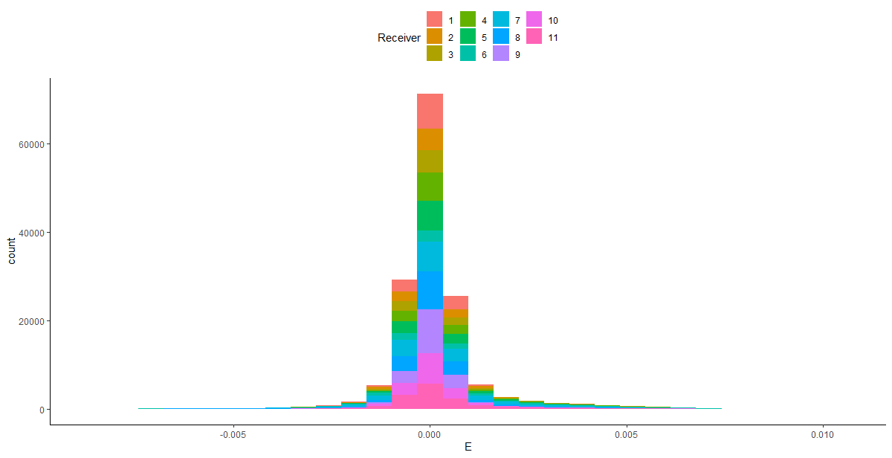
A pretty good synchronization model

Slide 26
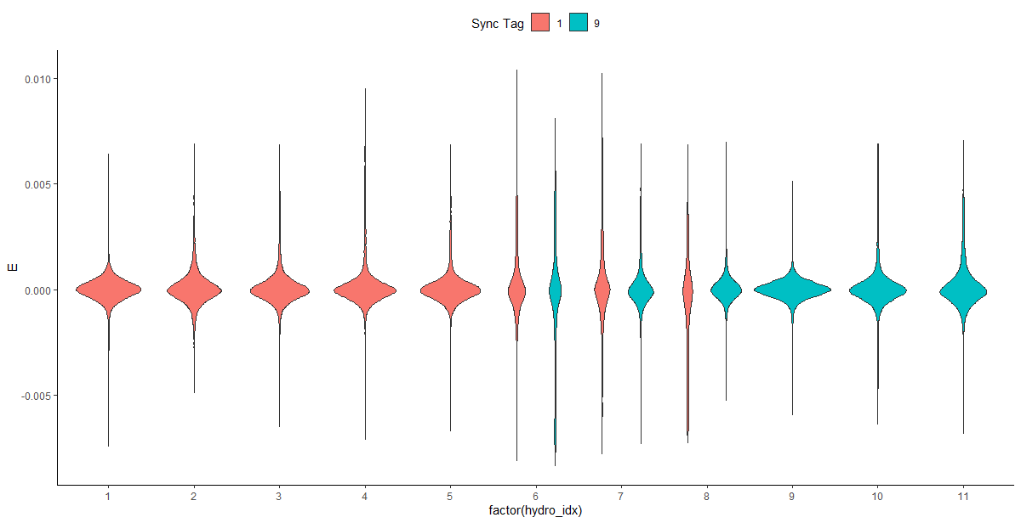
A pretty good synchronization model

Slide 27
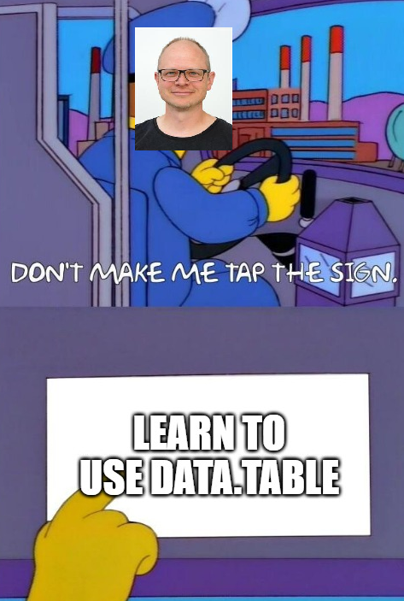
If you use YAPS you must know data.table

Slide 28
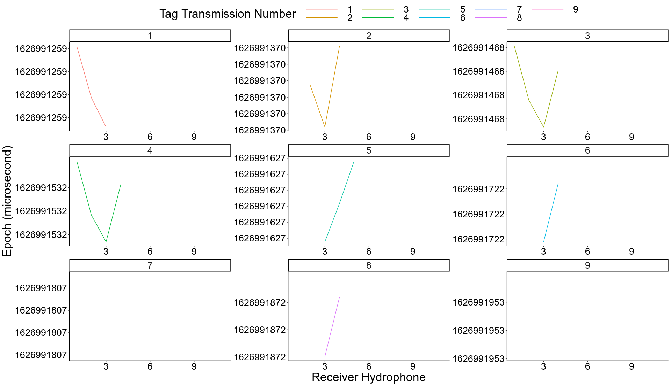
Steps to get positions
Synchronize your clocks (applySync)

Slide 29
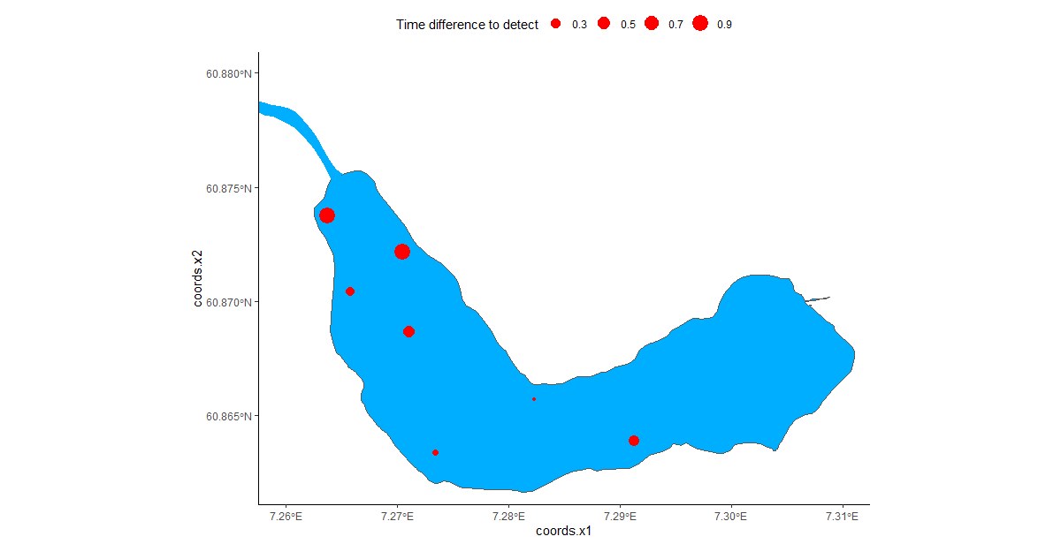
Steps to get positions
Synchronize your clocks (applySync)
Get time of arrival (getToaYaps)

Slide 30
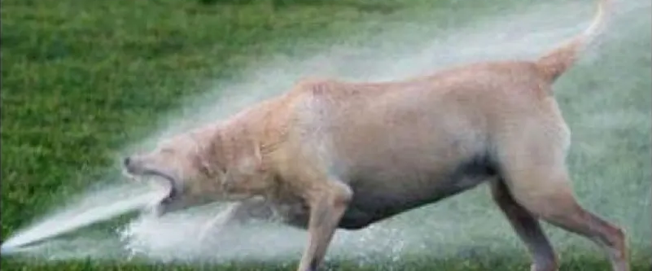
Steps to get positions
Synchronize your clocks (applySync)
Get time of arrival (getToaYaps)
runYaps

Slide 31
Some thoughts on challenges
Getting accurate depths for receivers in lakes
Ensuring vertical orientation of deep receivers
Changing water levels in regulated or tidal zones
Oblique receiver angles and oblong triangles
Just delete erroneous tracks or positions?
Can we make user-defined tweaks effectively?

Slide 32
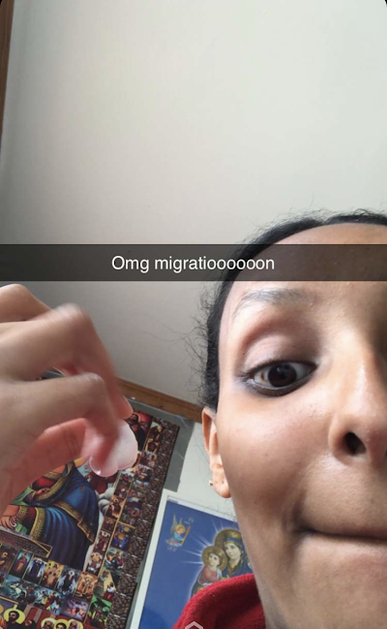
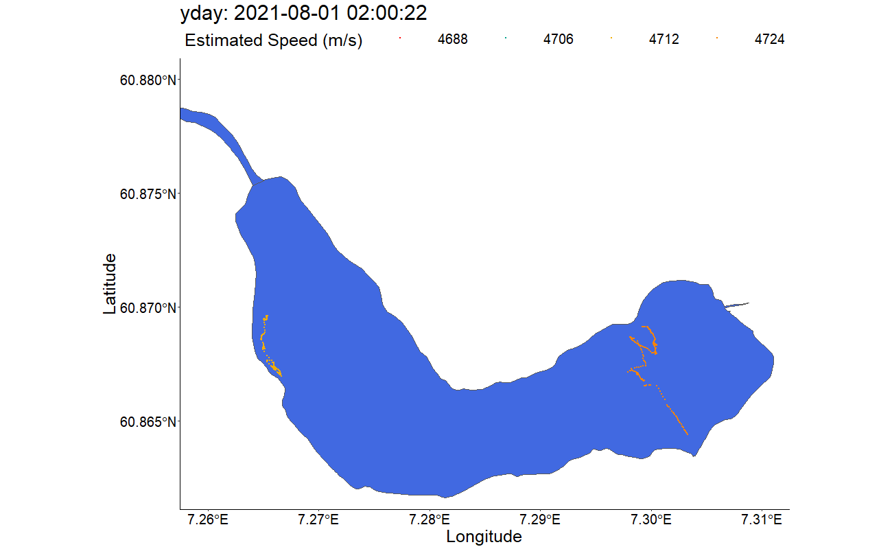
Once tracks fit and we have positions

Slide 33
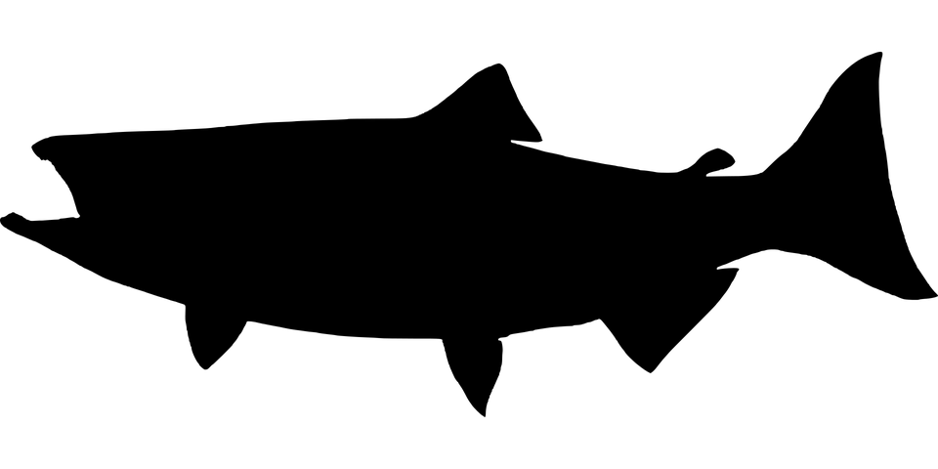
The step
The basic unit of movement
Movement is comprised of steps
Steps have lengths and turning angles
Used for HMMs, step-selection functions, etc

Slide 34
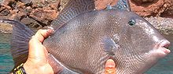
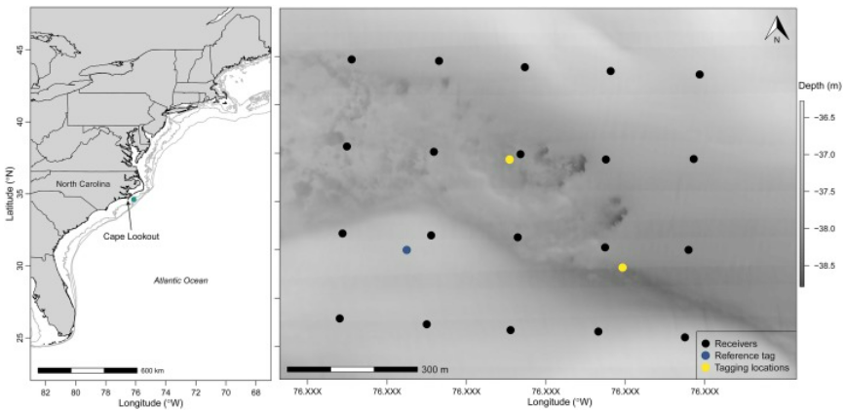
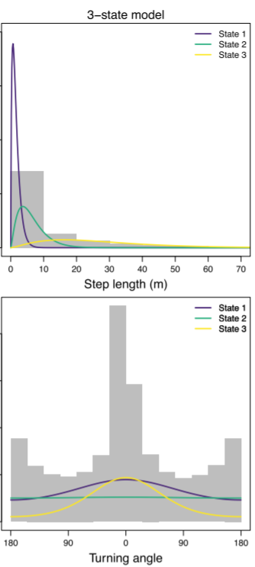
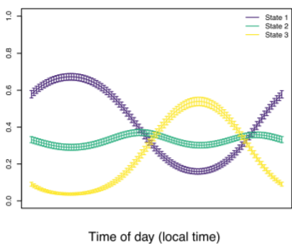
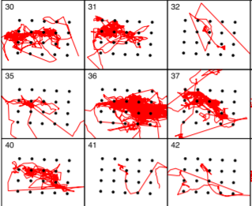
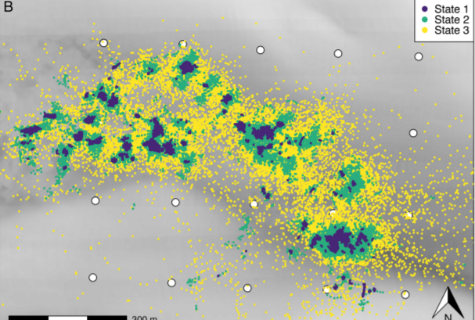
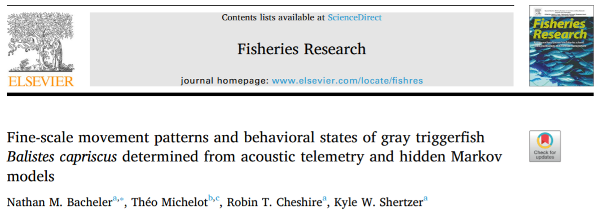
Applying positioning: Hidden Markov models

Slide 35
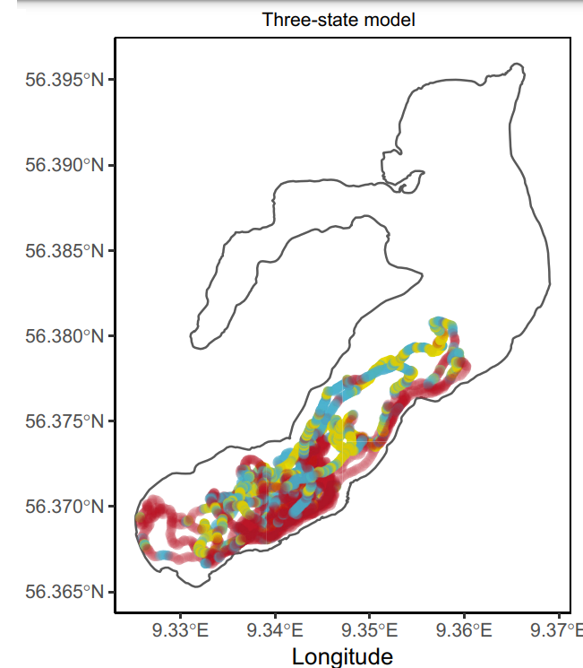
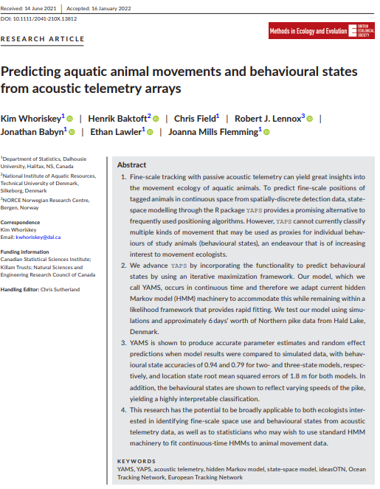
Applying positioning: Hidden Markov models

Slide 36
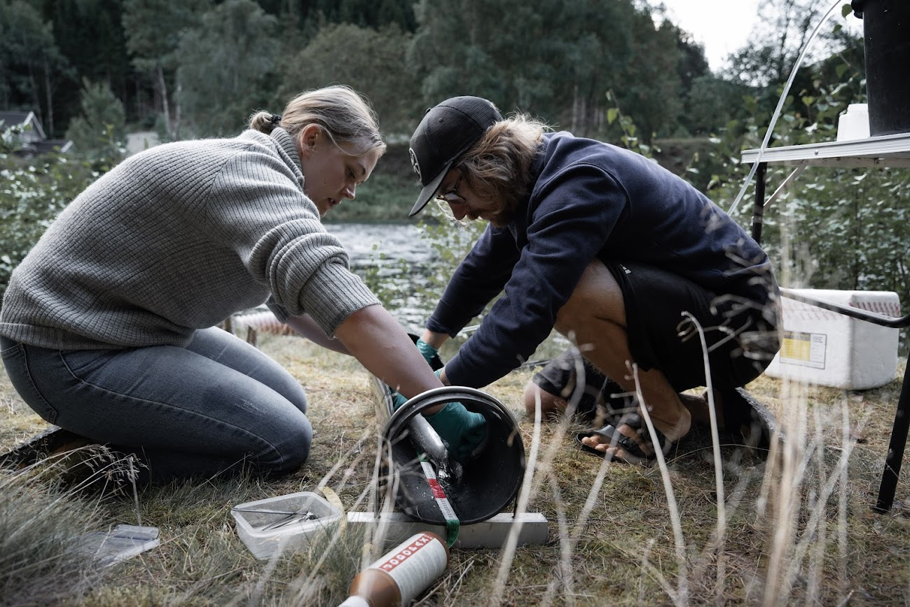
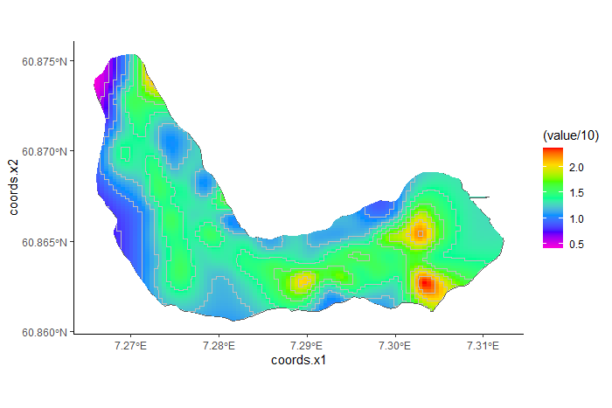
Applying positioning: generalized additive models
Trout acceleration activity in a lake

Slide 37



Applying positioning: Step selection functions
amt package (Signer et al.)
Griffin et al. 2021 FMS
Shannon Landovskis (in prep)

Slide 38



Applying positioning: menotaxis

Slide 39

Concluding thoughts

Slide 40

The positioning problem
Only have presence/ absence data at receiver locations
Can only make inferences within receiver array (small fish ideal)
Can massively misestimate key parameters if movement occurs beyond array
Missing data on untagged animals
Works best for
Lakes
Embayments
Massive arrays
Sedentary species

Slide 41
A beginner’s guide (and review)
Do you really need paths
They are the best! But some questions can be answered without
Prepare a realistic budget
Positions are resource intensive
Do you have a supercomputer
This will take a lot of time for realistic data sets
Any computing upgrades will save time
Do you know your study system very well
Not all created equal for positioning
Loss or movement of receiver can be catastrophic
Noise or interference that limits range can be so frustrating
Animals that exit array will be impossible to study
Take the time to test, make sure everything will be synced

Slide 42
miscYAPS::sync
sync_model<-miscYAPS::sync(hydros, # these are your hydrophones
detections, # these are the sync tag detections
ss_data, # this is your speed of sound data
keep_rate=0.5, # how much of they sync tag data do you want (50%)
HOW_THIN=100, # how much to thin the distribution
ss_data_what="data", # can change to “est” to estimate speed of sound
exclude_self_detections=T, # can change to F
fixed=c(1:9, 11:20)) # exclude any hydros that might have moved

Slide 43

miscYAPS::sync

Slide 44

miscYAPS::syncgrid

Slide 45

miscYAPS::errorplot

Slide 46

miscYAPS::transmits

Slide 47
miscYAPS::swim_yaps
tr<-miscYAPS::swim_yaps(fish_detections, # your tag data
runs=3, # how many re-runs should YAPS use to find best fit
rbi_min=60, # your minimum transmitter burst interval
rbi_max=120) # your maximum transmitter burst interval

